Slide 1
Out of the Silo: the GMILCS Linked Data Initiative
Notes:
Name and I and two colleagues are here to talk about our consortium's initiative to partner with Zepheira in order to get our bibliographic data out of our concealed database and onto the web where search engines can find it. ----Let me unpack that

Slide 2
Kevin French
Systems Librarian for GMILCS Inc. for 10 years.
With the System Administrator maintains servers, network connections, trains staff and provides support to the GMILCS libraries.
kfrench@gmilcs.org
Notes:
In my part, I’ll unpack that long first volley a bit, outline the timeline of events and what we hope to do in the future.
I am Kevin

Slide 3

Who is GMILCS inc.?
GMILCS, Inc. established in 1992
GMILCS, Inc. is a nonprofit consortium of public and academic libraries in New Hampshire.
The GMILCS, Inc. consortium serves the libraries of Amherst, Bedford, Derry, Goffstown, Hooksett, Manchester, Merrimack, Milford, Salem, Windham, and New England College.
Libraries share
Polaris ILS
Resources
Courier
Staff Experience
GMILCS History https://findit.gmilcs.org/polaris/library/events.aspx?ctx=1
Notes:
The next question you might have is, “Who is GMILCS?”
several specialized groups such as our Metadata Integrity Group and Circulation/ILL group
I enjoyed reading the GMILCS history before I applied more than 10 years ago

Slide 4
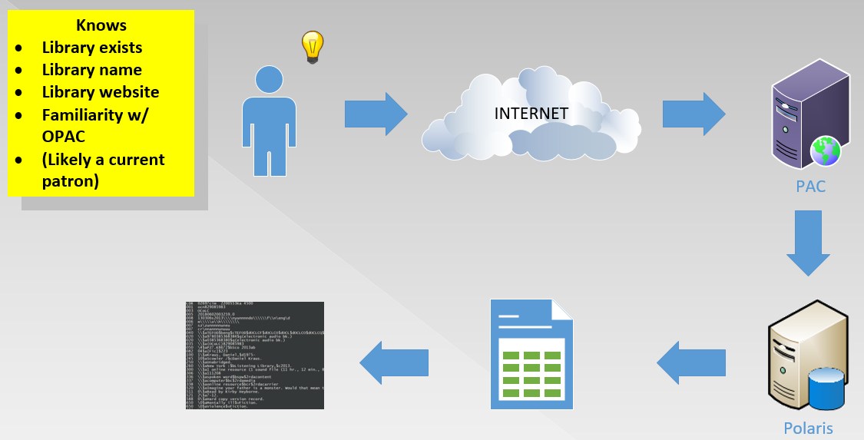
Why Linked data? - Current situation
Notes:
In the silo?
CURRENT PATRON
ILS/PAC optimized for current patrons who know the library exists and how to use PAC
ILS search good but not as good as well funded search providers

Slide 5
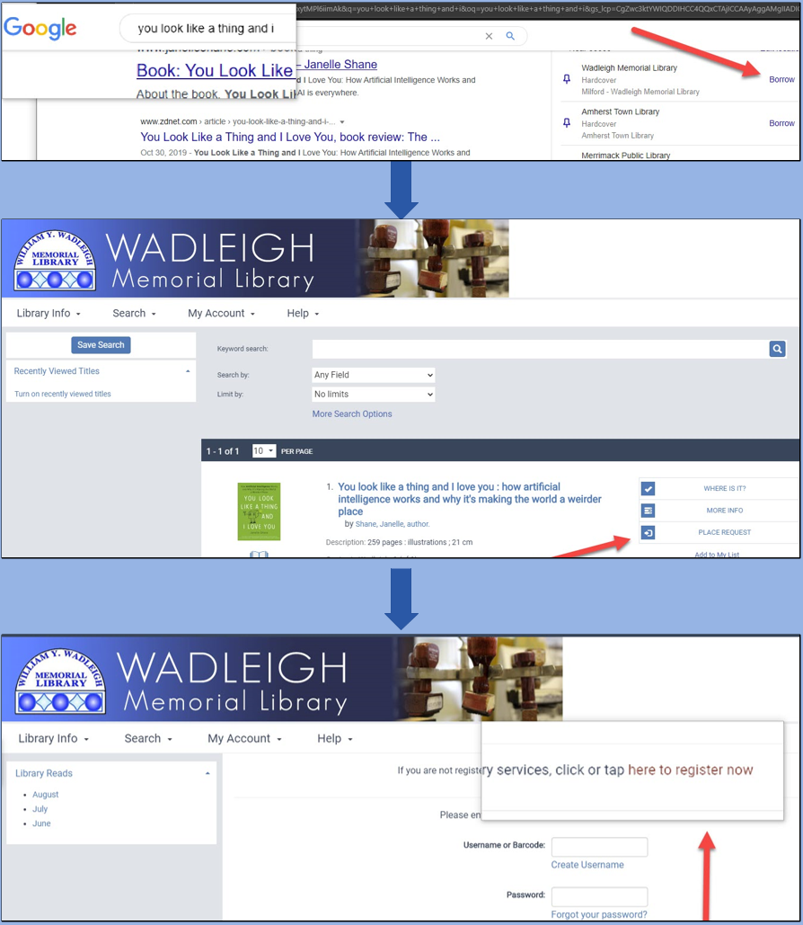
Why Linked data?
Potential patron in the area uses Google to search for a book.
Google geolocation finds nearest library with the option to borrow in the Google Knowledge Pane
Potential Patron is directed to PAC
Potential patron offered opportunity to register
Notes:
Out of the silo?
Linked data solves some of those problems for instance…ANYONE in your area can just type what they want in their search engine

Slide 6
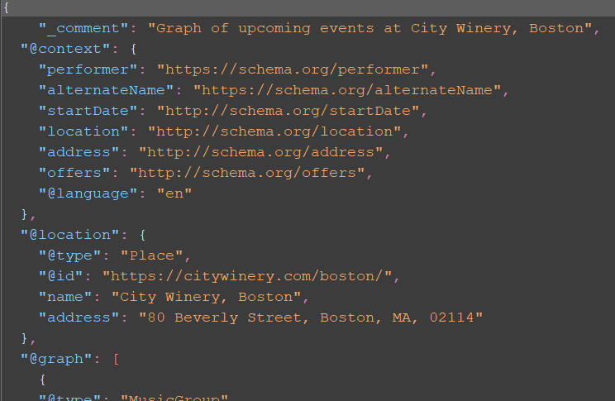
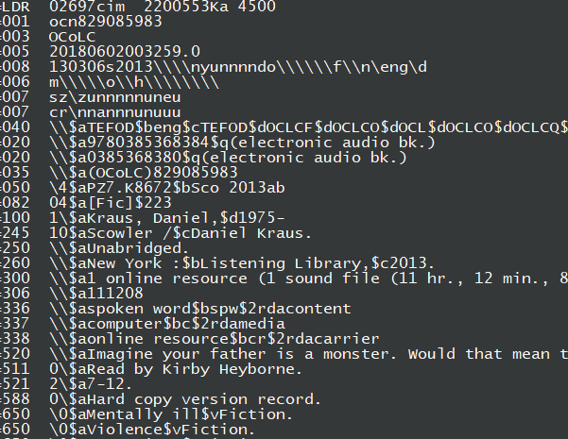
Linked Data (JSON-LD) VS marc
Notes:
How?
Google can read linked data but not MARC.
MARC didn’t envision new formats.
LD can change name spaces to accommodate new formats as they arrive.

Slide 7
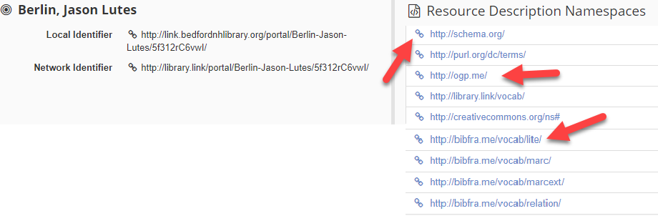
Namespaces used in our library.link sites
Notes:
Namespaces available on our linked data pages.

Slide 8
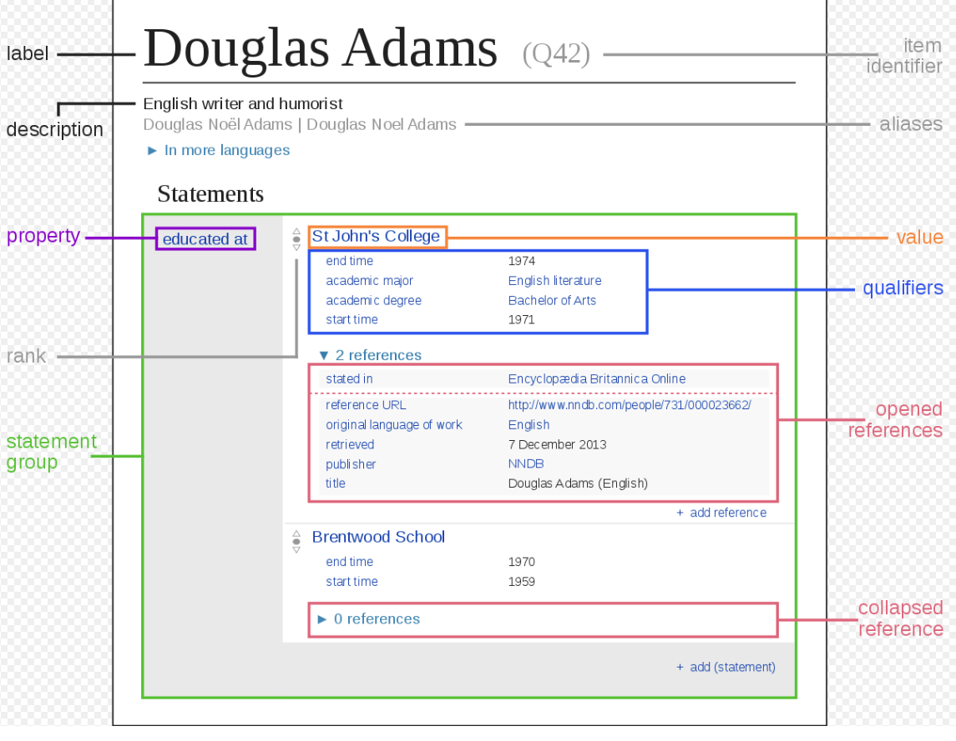
Wikipedia USES A SIMILAR combination
http://www.w3.org/2000/01/rdf-schema#
http://www.w3.org/1999/02/22-rdf-syntax-ns#
http://schema.org/
http://purl.org/dc/terms/
http://ogp.me/
http://library.link/vocab/
http://creativecommons.org/ns#
http://bibfra.me/vocab/lite/
http://bibfra.me/vocab/marc/
http://bibfra.me/vocab/marcext/
http://bibfra.me/vocab/relation/
Notes:
Compare our linked data namespaces to Wikipedia via Wikidata

Slide 9
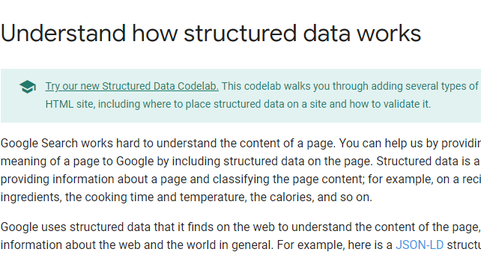
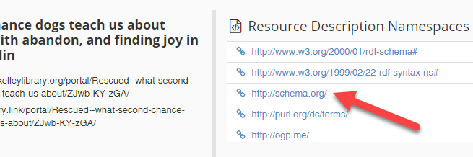
Google supports Schema.org
https://developers.google.com/search/docs/guides/intro-structured-data
http://link.manchesterlibrary.org/resource/i7KvJv9U_Pg/
Notes:
Google’s guide for web developers.
Google suggests developers use schema.org to enable better crawling

Slide 10
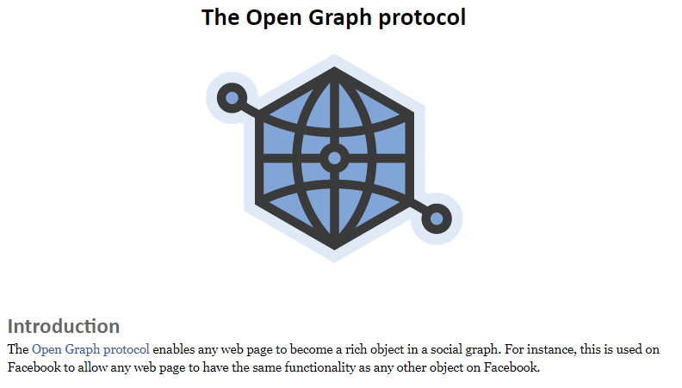
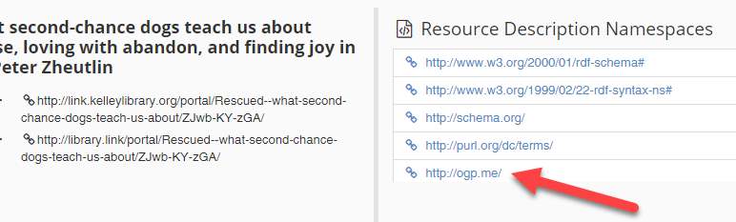
Facebook’s Open graph protocol http://ogp.me/
Notes:
Facebook has their Open Graph Protocol which

Slide 11
Why Zepheira?
Converts our data to linked data
Meets with Google regularly
Provides reputable storage and standards that search engine providers trust.
https://zepheira.com/
Notes:
Why Zepheira?
We can transform our data ourselves and host it but
We don’t have the time to commit or server
Google et al has no reason to trust us – reputation management

Slide 12
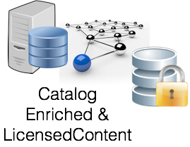



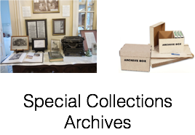

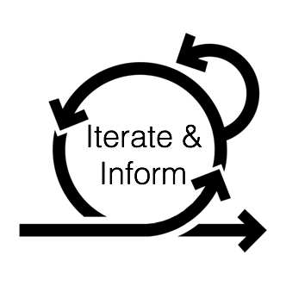






Transform
Link
Publish
Consume
Organic
Search
Social
Harvest
Direct
In Library
3rd Parties
Apps
Gadgets
Notes:
Zepheira process

Slide 13
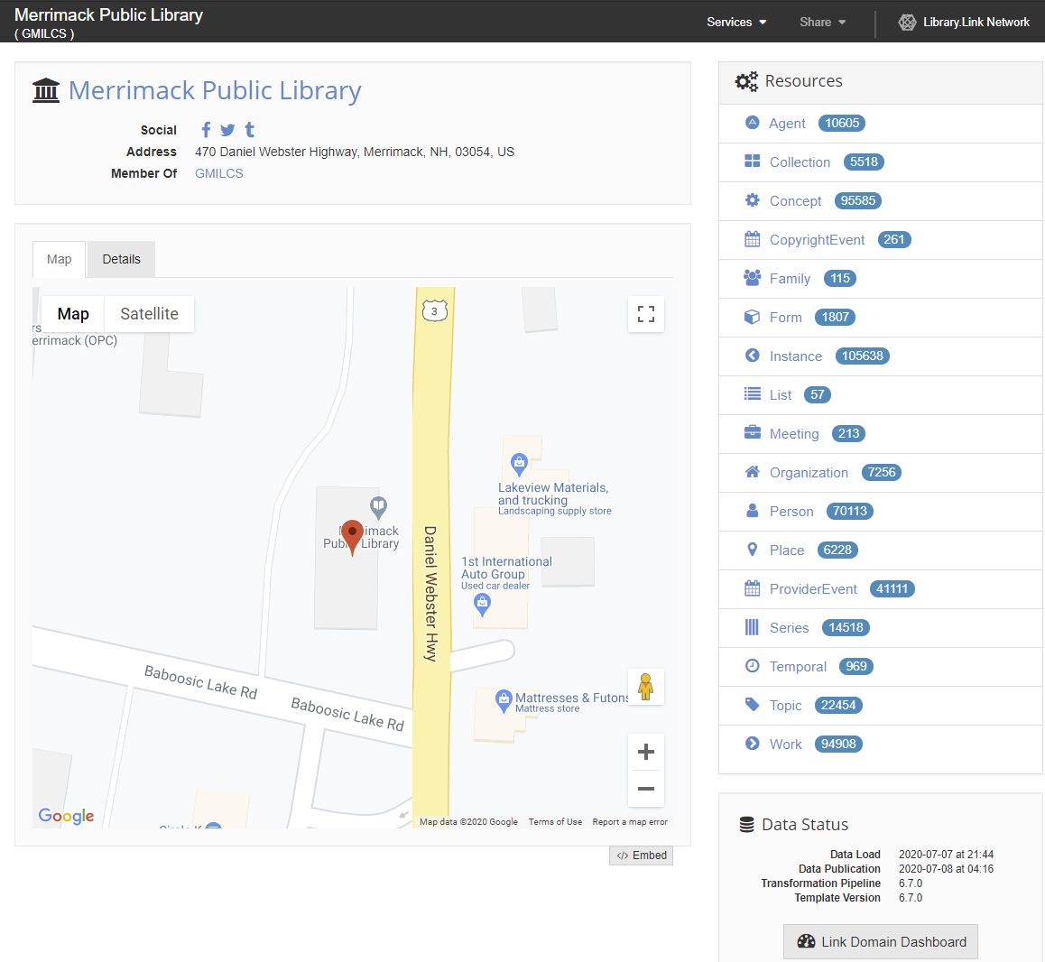
Library link pages
Notes:
Zepheira published our data and provides linked data pages for use to work with.
Staff view

Slide 14
Timeline of events

Slide 15
In the beginning-2011– Semantic web
Listserv discussion, “Have people heard of this?” Should we look into it?
Webinar- ALCTS: Linked Library Data March 2011Linked Library Data: Tuning Library Metadata for the Semantic Web, with Corey Harper”
Set up Ebsco Alert - wait
Notes:
Mild mannered investigation library uses for the semantic web.
Like Blockchain and Libraries – Know what each is but how are they together?
Nothing happened for a long time

Slide 16
2015 – Things start to heat up
GMILCS System Administrator attended promising ILS conference sessions.
Directors, too, returned from PLA enthusiastic about linked data.
Enrolled Zepheira's Practical Practitioner training series on Linked Data and BIBFRAME.
Cleaning data
Converting MARC records
Publishing data
Authority references
BIBFRAME
Notes:
GMILCS System Administrator attended PUG polusrgroup
Directors, too, ---asked us to investigate
GMILCS staff enrolled in Zepheira's Practical Practitioner training series on Linked Data and BIBFRAME.
Cleaning data
Converting MARC records
Publishing data
Authority references
BIBFRAME

Slide 17
2016 – Things started to cool down
Expectations unclear.
Results difficult to measure.
Asked to keep an eye on developments.
Notes:
Unclear how to measure results (ROI)
How stake holders would respond without clear measures
board decided not to move forward but asked us to keep Linked Data on our radar.

Slide 18
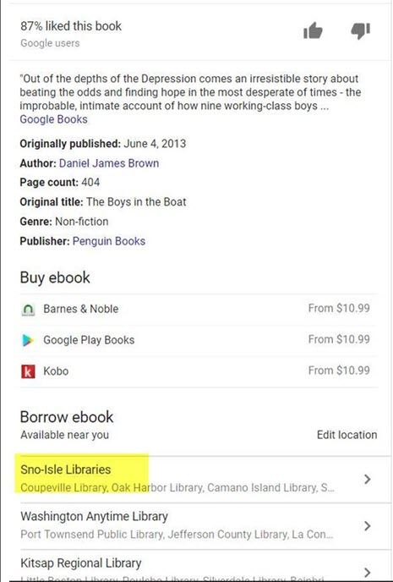
2017 – Things start getting warm again
IUG 2017 presenters showed early adopters good results:
Google introduced borrow-ability in Knowledge Panels (Overdrive) late 2017.
Social media links working.
Native search results from community members.
Back to the Board - YES
Notes:
Innovative User Group
KP eBooks
Knowledge Panel where IMDB and Wikipedia live. Trusted sources!
Board said yes LETS DO IT

Slide 19
We signed up!

Slide 20
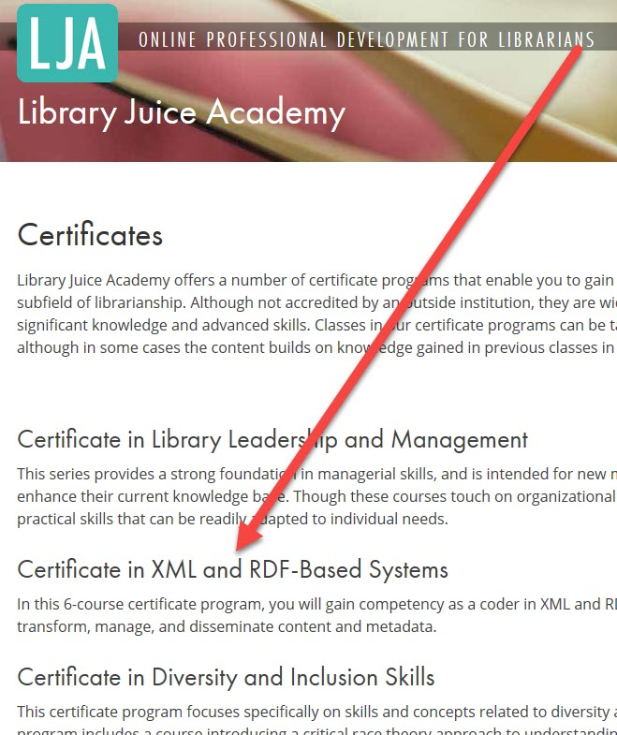
Early 2018 – publication preparations
Reviewed data export profiles.
Publish as individual libraries over all GMILCS.
Learned more about the mechanics.
Notes:
Reviewed data to be exported.
Decided each library individually rather than Consortium.
I took LJA’s certificate in XML and RDF based systems – to understand environment – GREAT COURSE!!

Slide 21
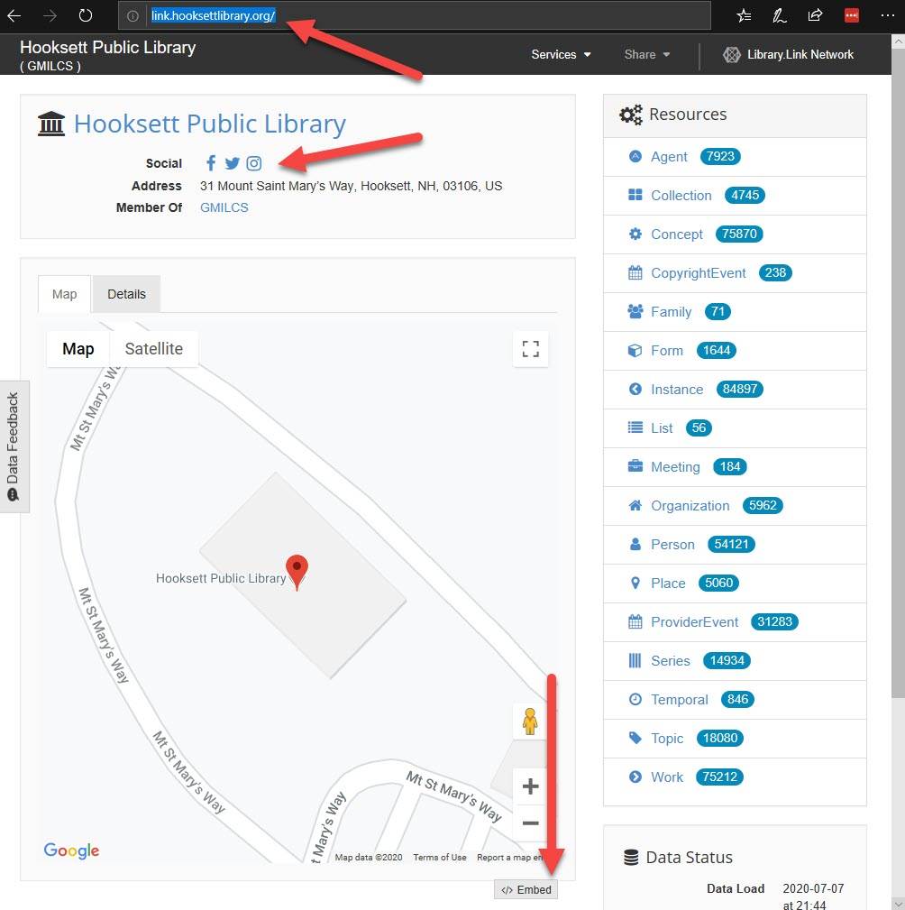
June 2018 - data published!
Each library has a linked data with…
Location map
Transformed data
Social media connections
Statistics
Library.link to link.”library”.org
Notes:
Initially on library.link then each library’s domain for better search results

Slide 22
Problems? – a few
Immediate issues
No resource entities
Not all libraries displayed
Data cleaning problems exposed
Ongoing issues
Work we do impacts linked data downstream
Despite problems
First month statistics indicate month good at 64 hits
Notes:
Resource entities – NEC – Bad because students likely use Google first –
Data CLEANING Angela will talk about
We’ll change something and find out after our data refresh something broke

Slide 23
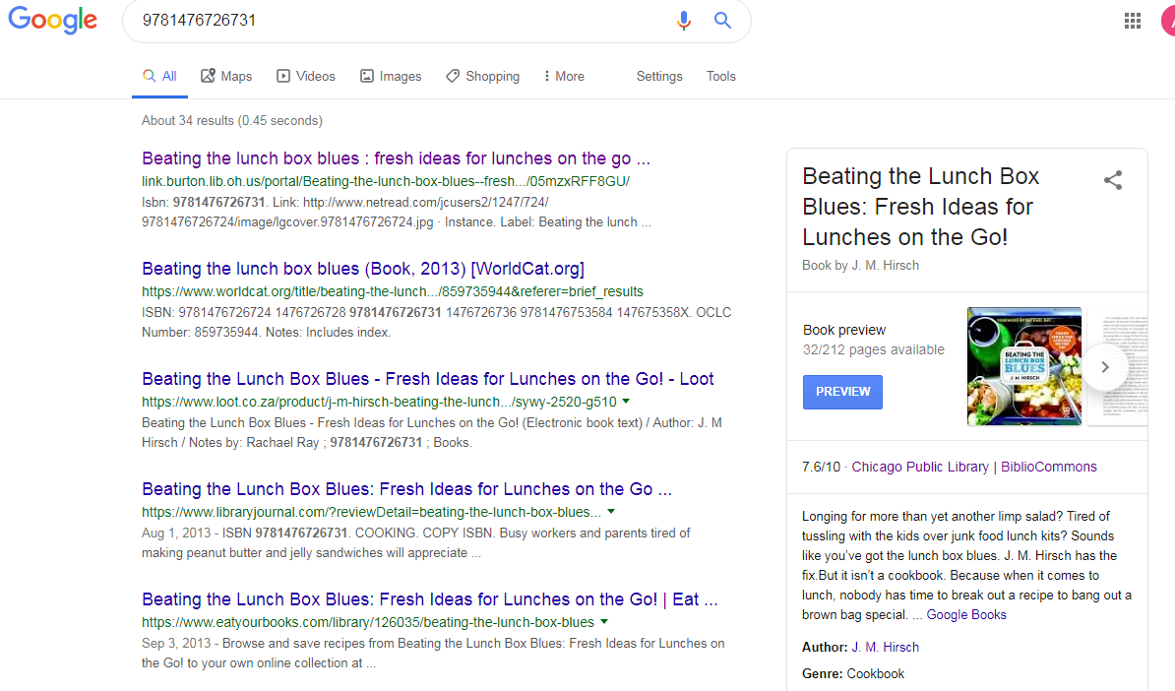
Initial 2018 search engine results
Notes:
Initial results—PRETTY GOOD-- came in main search results
Often required
very specific search
name of the town
zipcode
library name.

Slide 24
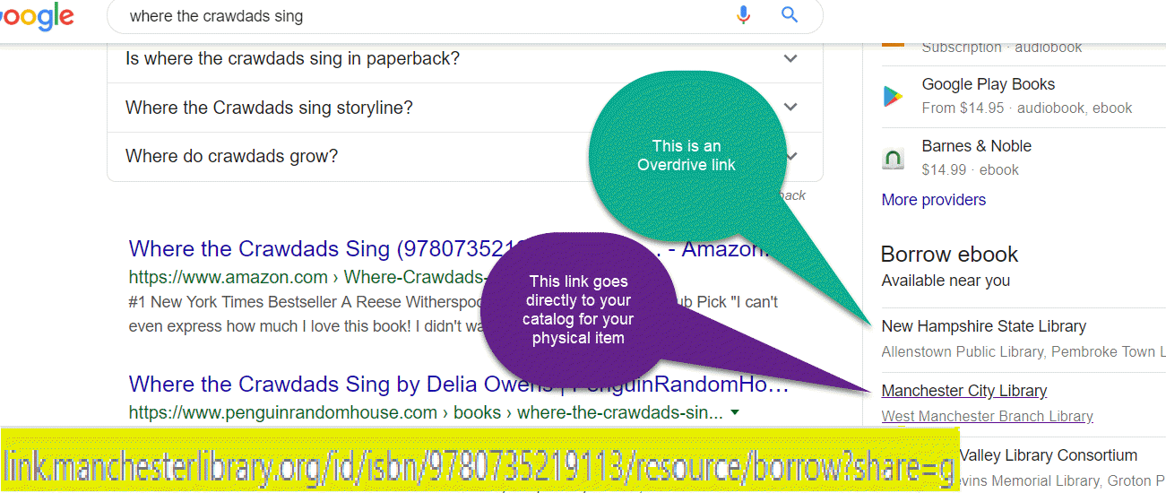
Later results-Google Knowledge Panel
Scheduled to appear Jan 2018 but delayed (by Google) until spring 2019.
eBooks appearing in the Google Knowledge Panels.
Unfortunately, initially, only our Manchester City Library generated results
Notes:
We NOW see the effects of linked data every time we use google.
Results may vary

Slide 25
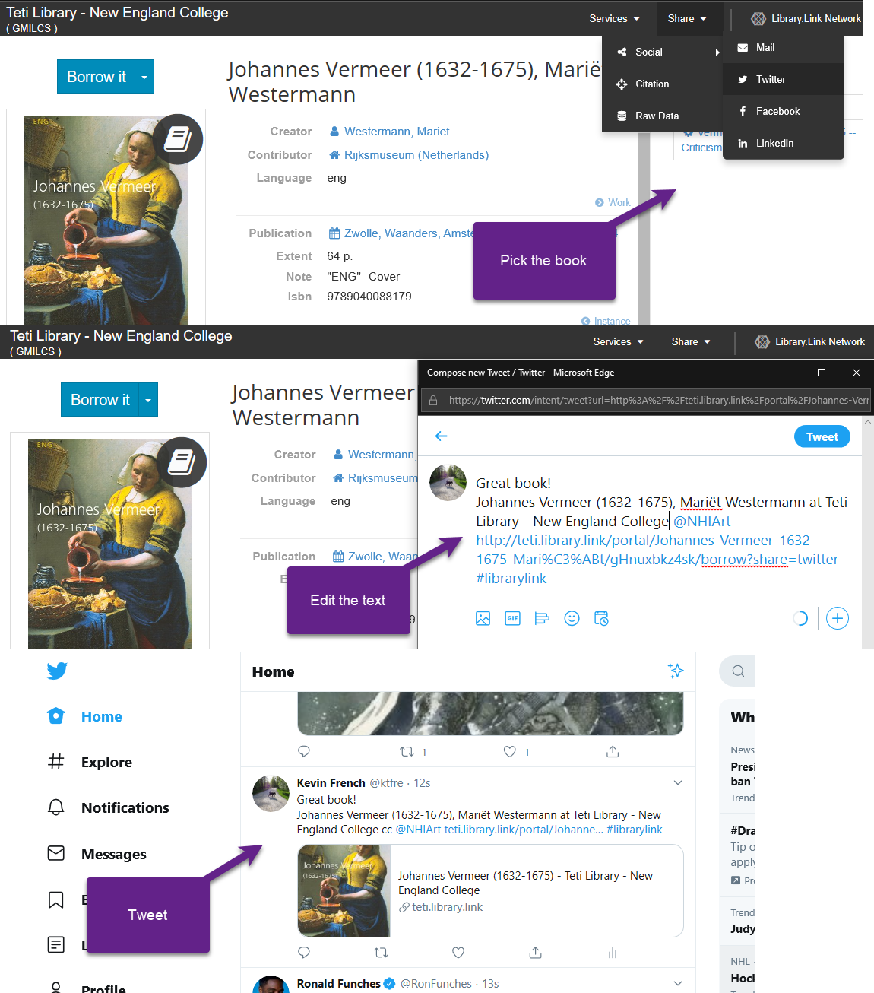
2018 – out of the box features
Social media accounts embedded in our linked data …
Pick a title
Edit the post’s text
Click to post
Notes:
Library Social media accounts on linked data sites allow for quick sharing of items

Slide 26
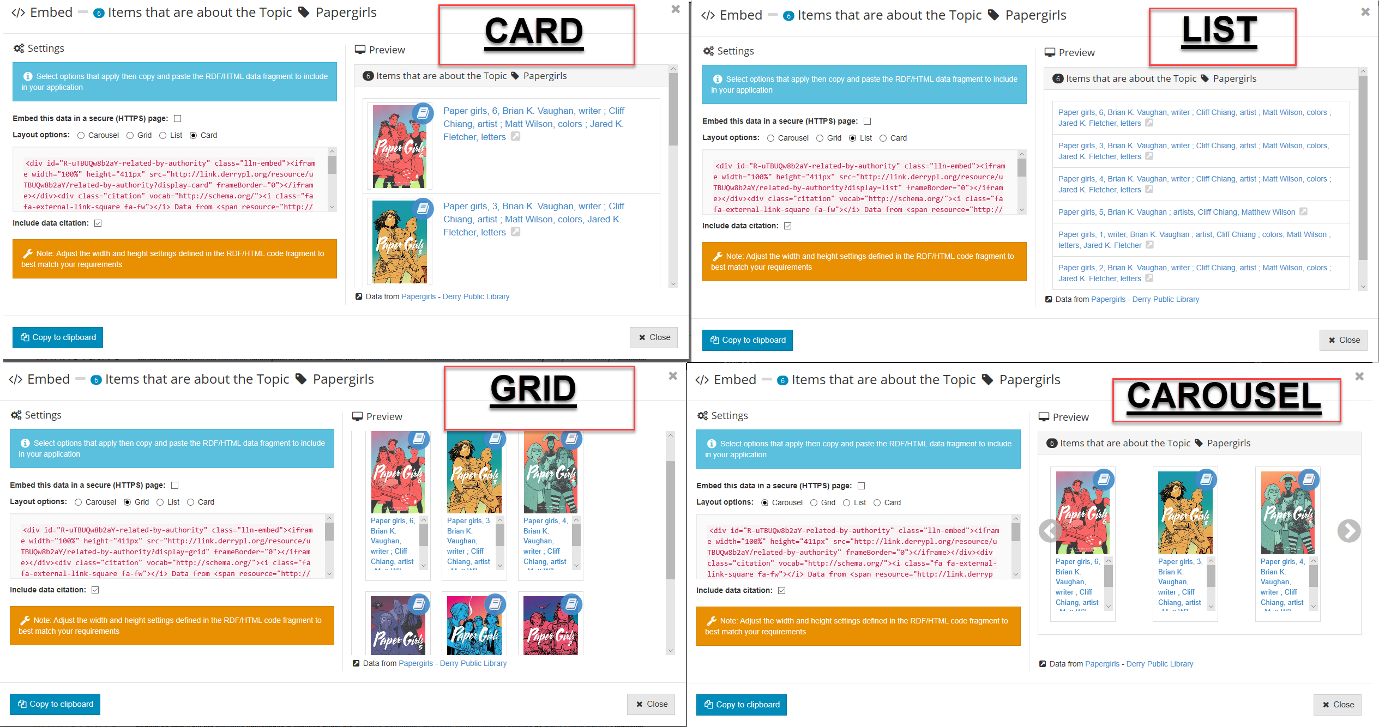
2018 – out of the box displays
Notes:
Choose from multiple displays options for items grouped by subject
Sue will go into this much more

Slide 27
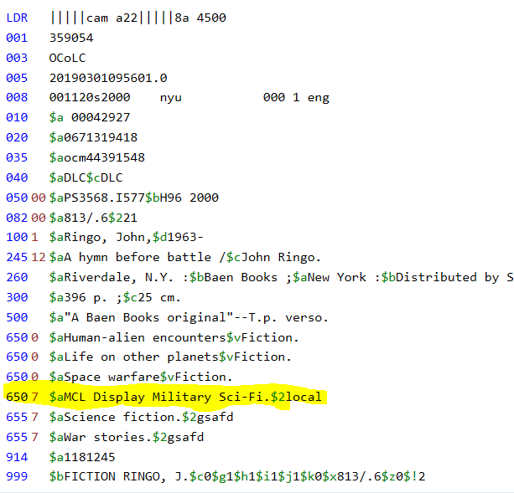
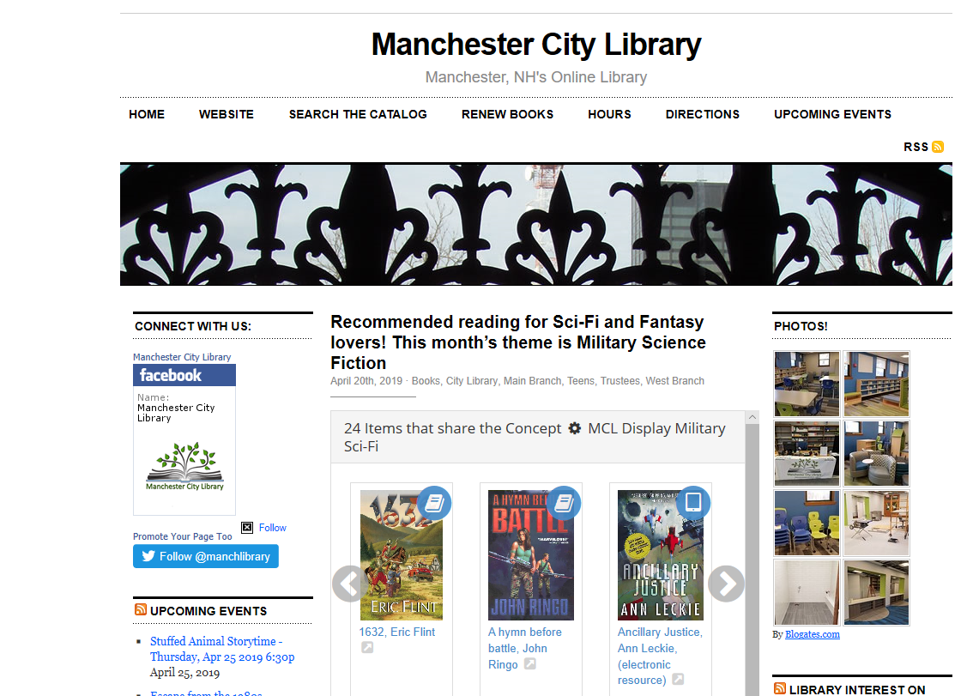
Initial foray into Custom displays
ENTER LOCAL HEADING
GATHER WITH NAVIGATOR FOR DISPLAY
Notes:
Historically temporary 650 now 690 for permanent special collections
--Sue will go into more detail

Slide 28
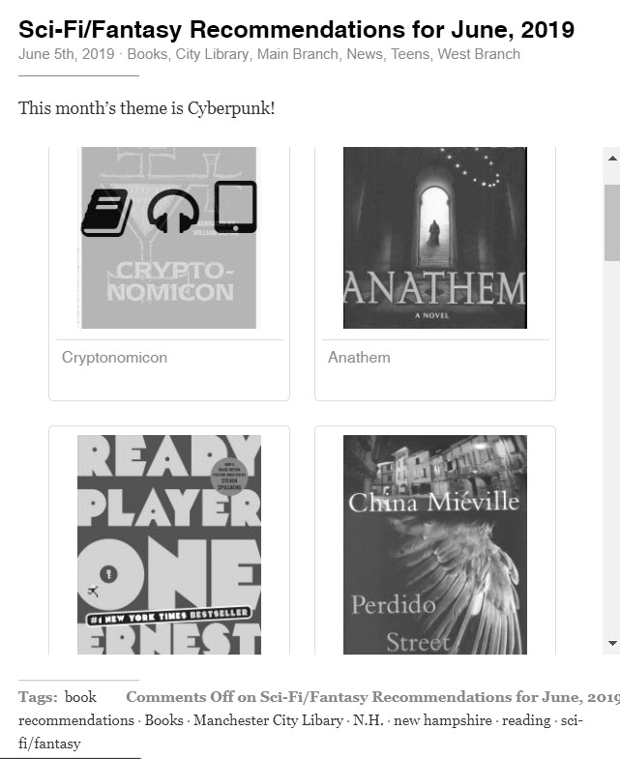
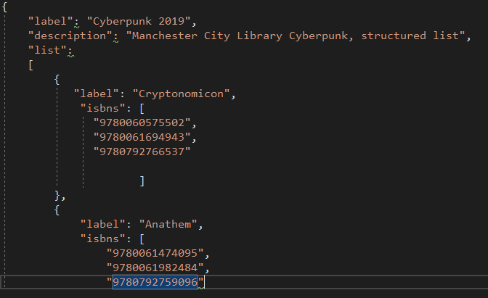
Custom picked displays
Notes:
Now for temporary lists, we create code to run through Zepheira tools
Again--Sue will go into this process

Slide 29
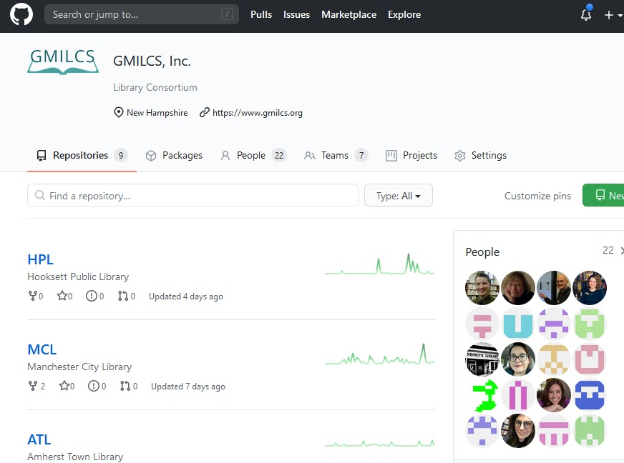
Sept 2019-github
GMILCS GitHub to share display code.
GMILCS GitHub Wiki contains instructions
COMING SOON - GitHub pages website with code examples, embedded video etc…
Notes:
I only mention it because I made a org Github to share the code

Slide 30
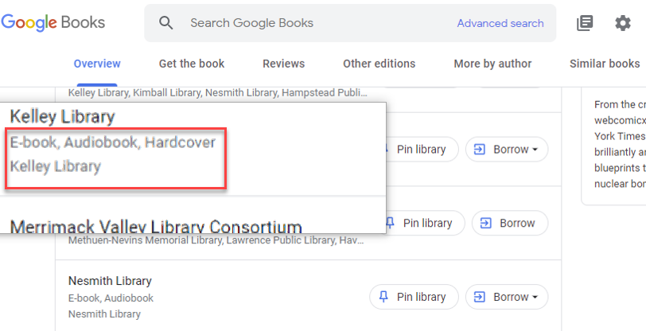
November 2019 - Google Books
Google completed a relaunch of Google Books introducing multiple formats, beyond eBooks. Specifically hardcover and paperback.

Slide 31
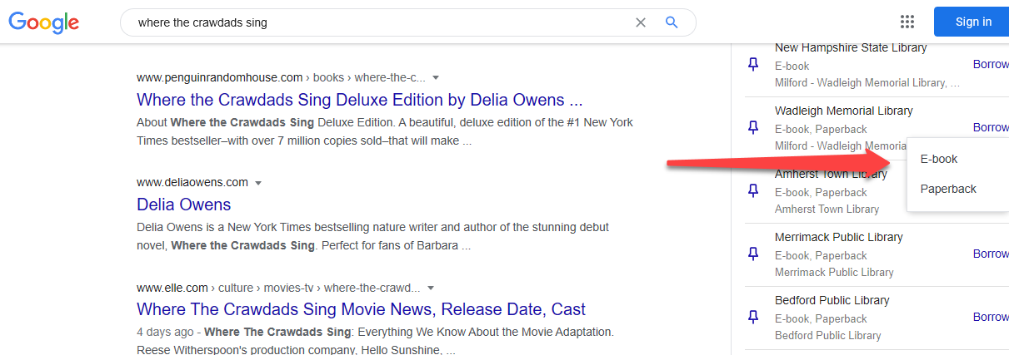
December of 2019 knowledge panels included multiple formats

Slide 32
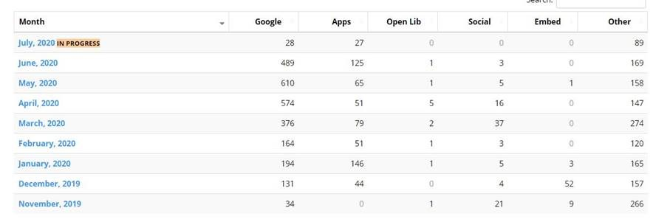
2020-HIGHLIGHTS
Borrowing for multiple formats mobile apps.
GMILCS Trustee unexpectantly found book via Google
Introduction of User Engagement Statistics.
Notes:
Library Trustee found book and Asked how long that’s been going on????
Despite loading issues in late 2019 and early 2020, good stats

Slide 33
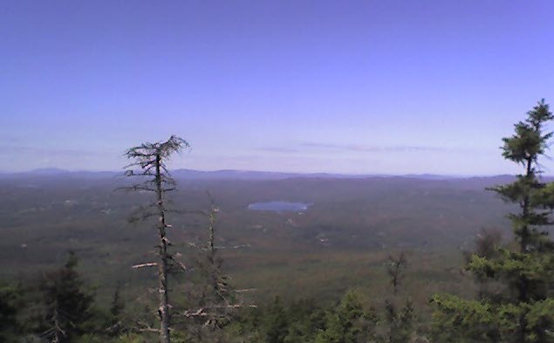
opportunity on the horizon

Slide 34
Open Libraries –
Provide free digital books to patrons where there are matches to holdings.
Libraries can add their holdings into Open Libraries to increase lending counts.
With linked data collection adds and deletions known automatically
Searchers of OpenLibraries notified our libraries have a physical copy
http://openlibraries.online/ via The Internet Archive
Notes:
31,619 crossover with GMILCS items
COVID – opportunity to keep library books available
ADA – available books for people with JAWS or other screen readers.

Slide 35
Resources
https://libraryjuiceacademy.com/certificate/xml-and-rdf-based-systems/
http://www.ala.org/alcts/resources/monographs/linked-data-perplexed-librarian
http://www.ala.org/news/member-news/2018/12/social-tagging-linked-data-environment
https://www.alastore.ala.org/content/linked-data-libraries-archives-and-museums-how-clean-link-and-publish-your-metadata
LD4 https://www.youtube.com/channel/UC6ohcLJ1I3yAFjpUaOlT_zA
Linked Data Engineering https://www.youtube.com/watch?v=ON0wf0SEPx8&list=PLoOmvuyo5UAfY6jb46jCpMoqb-dbVewxg&index=2&t=0s

Slide 36
Linked Data for catalog cleanup
Angela Brown
Technical Services Librarian
Amherst Town Library
Notes:
-NETSL Public Library Member-at-Large
-NHLA Tech Services Ad Hoc Committee chair

Slide 37
Metadata Integrity Group (MIG)
Consists of technical services staff member from each GMILCS library
Responsible for maintaining shared catalog
Agree to technical services policies and procedures
Notes:
-GMILCs catalogers and technical services staff form the Metadata Integrity Group (MIG)
-No centralized cataloging service. Each library employs a cataloger or tech services dept.
-Large libraries have departments with full staff. Small libraries have single person.
-Despite being decentralized. Members agree to a shared set of policies and procedures
-Meets bimonthly to discuss procedures
-Also, keep up with latest trends and developments

Slide 38
MIG and Linked Data
Patience!
Web results take time
Prepare!
Continuing education courses
Clean!
Linked Data site for catalog cleanup
Notes:
MIG was involved early on and understood getting data on the Web would take time
In the meantime, many members participated in CE (i.e. Linked Data for beginners class UWM in 2018) to gain a better understanding of LD principles
-Kevin visited libraries to go over LD and each library’s individual site
Linked Data site as an opportunity for data cleanup. Made sense after authority control project.

Slide 39
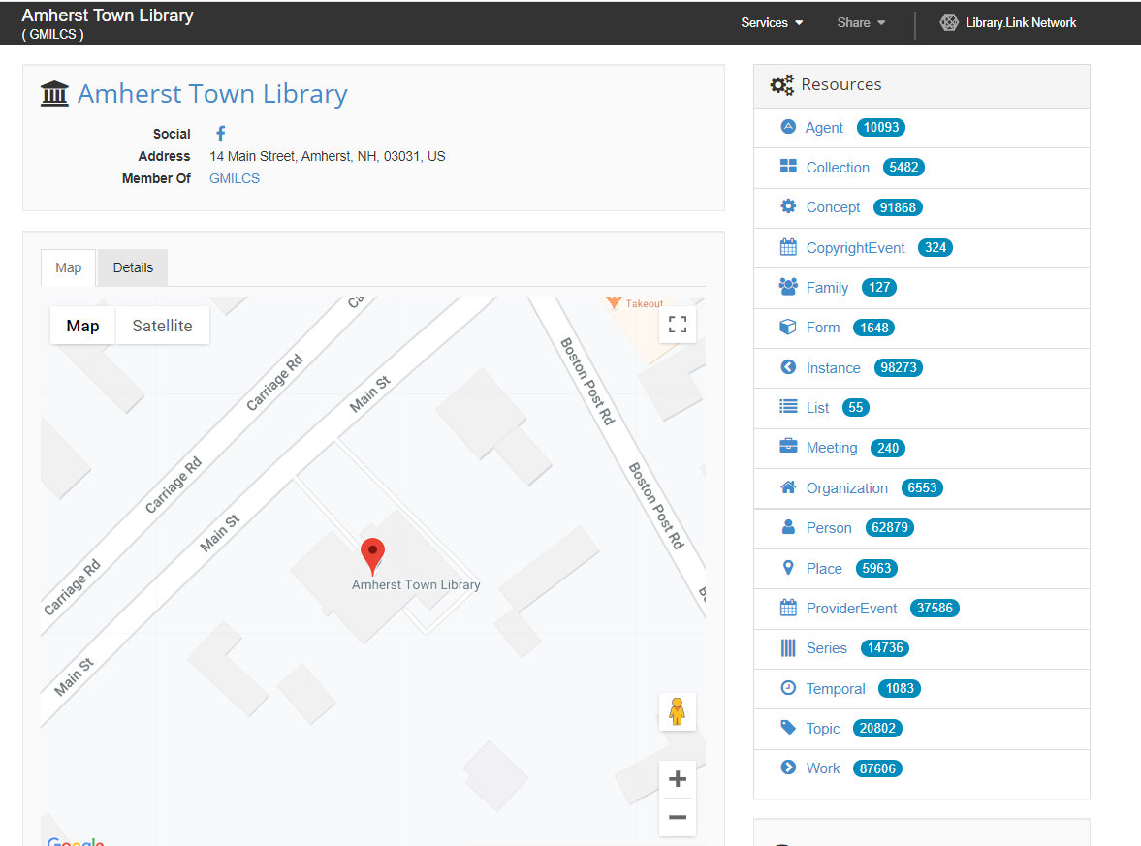
Amherst Town Library Link Page
http://link.amherstlibrary.org/
Notes:
-This is a view of the Amherst Library Link Page
-We will look at three Bibframe Resources: Form, Person, and Provider Event in the context of data cleaning.
-First we will browse the resources and then use the Resource Navigator to find problems.

Slide 40
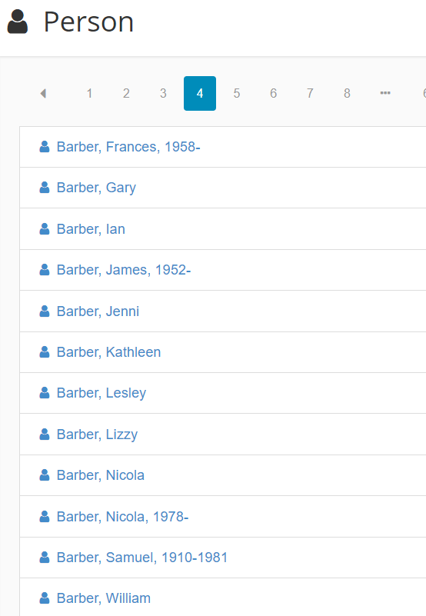
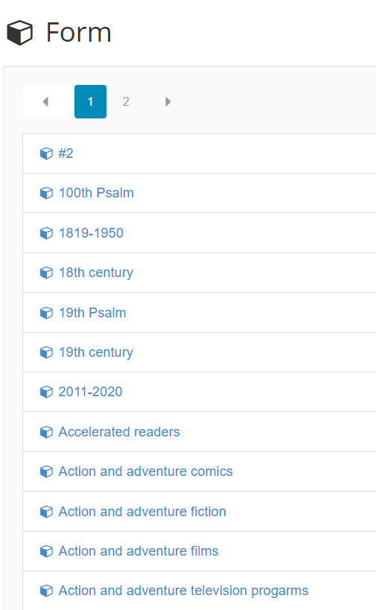
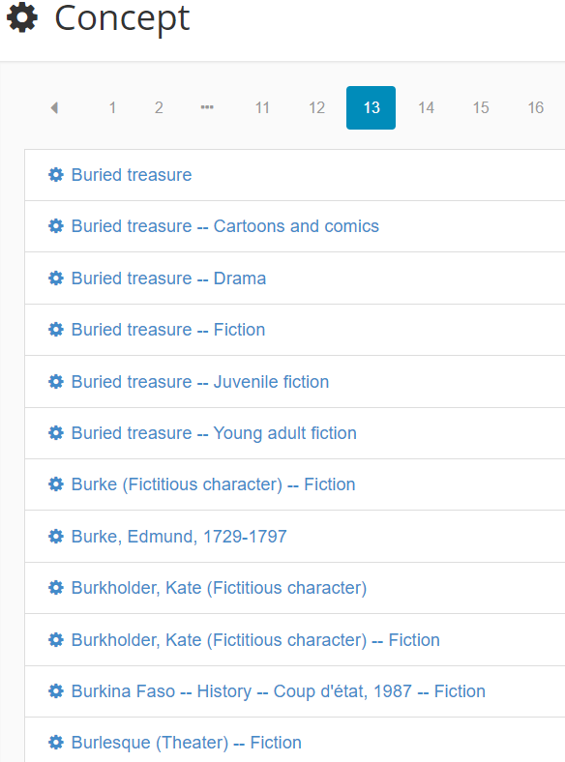
Amherst Town Library’s Link Page
Notes:
-Here is a quick view of the Person, Form, and Concept resources from browse (clicking on any of these resources from the main Link page).
-Person: http://bibfra.me/vocab/lite/Person/Individual (alive, dead, undead, or fictional) in relation to a resource MARC 100, 600, 700
Form: http://bibfra.me/vocab/lite/Form/
Category or genre that describes what the resource is. MARC 655 field or 6xx subfield 2
Concept: http://bibfra.me/vocab/lite/Concept/
Term describing the subject, aboutness, idea or notion of a resource. MARC 6xx fields

Slide 41


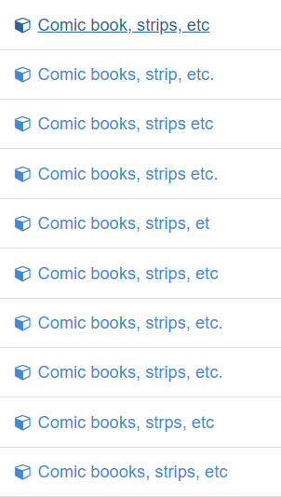
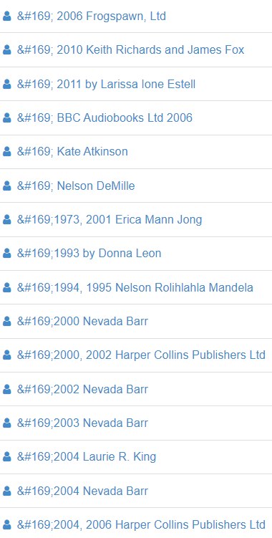
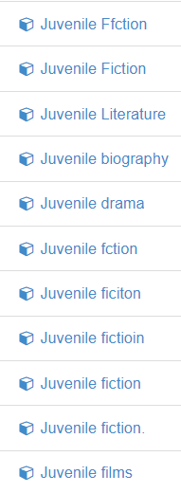
Browsing Resources for errors
Notes:
-Some examples of browsing Resources for errors in the 6xx fields.

Slide 42
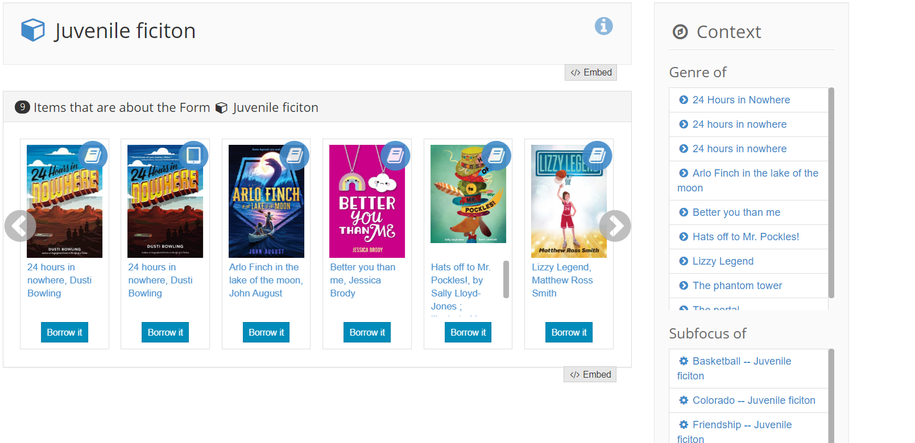
Example: Juvenile ficiton
Notes:
-A closer look at one of the erroneous headings.
-Clicking on the heading lists all of the Items that have the heading.

Slide 43
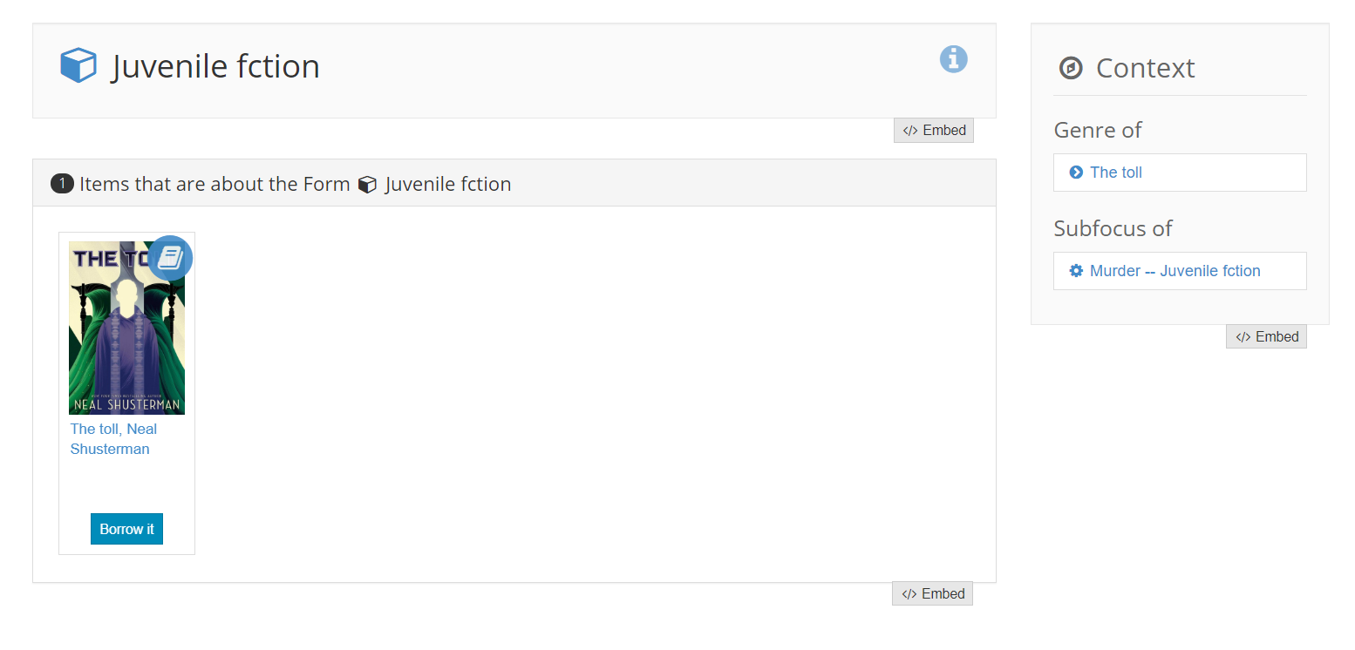
Example: Juvenile fction
Notes:
-Here is another example. You can see the subject heading in context. i.e. where it appears in the bib record.

Slide 44
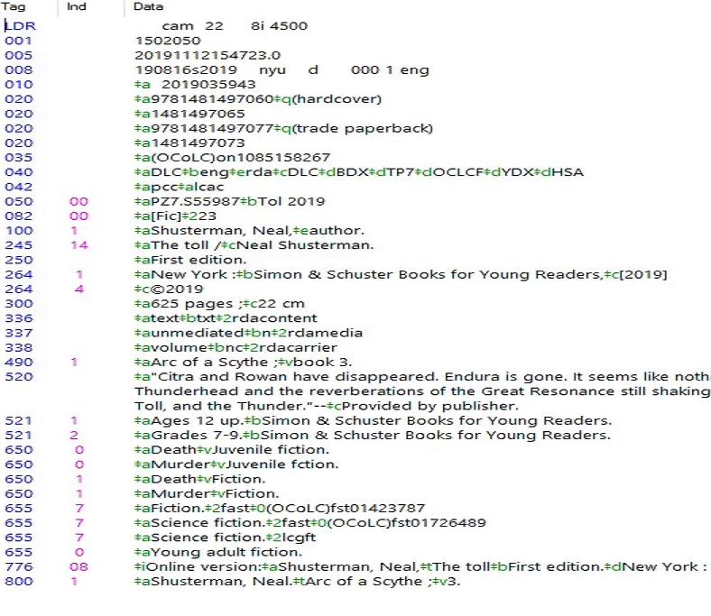
Example: Juvenile fction
Notes:
-This is the MARC record and the misspelled subheading appearing in the 650$v.

Slide 45
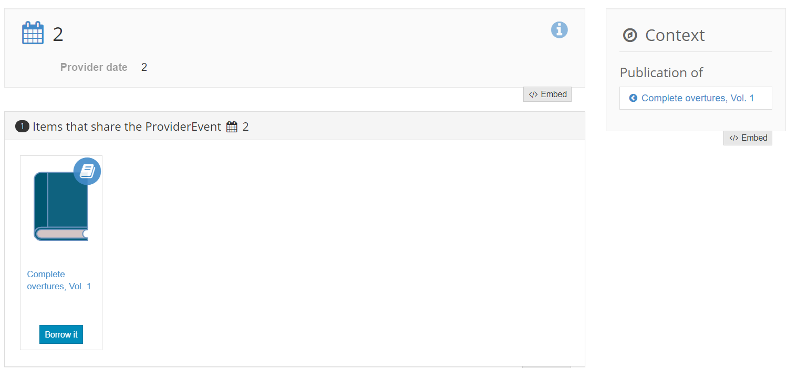

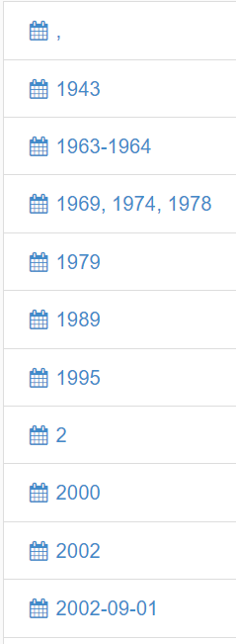
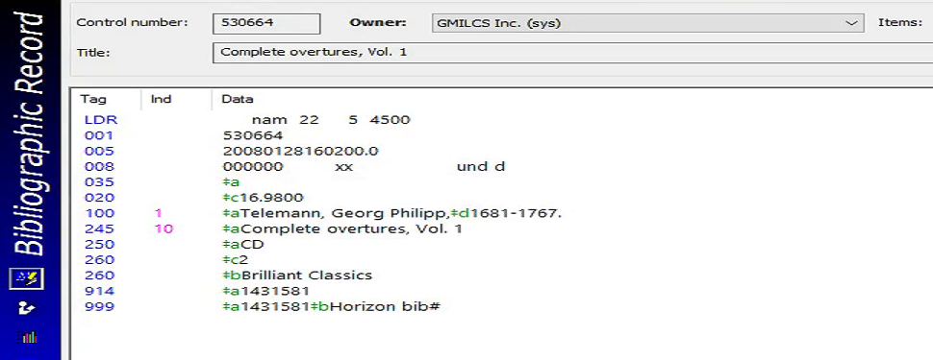
Example: 2?
Notes:
-This is an example of browsing Provider event. There a few strange entries here. First there is “2”. After clicking on
Provider Event: Event associated with the publication, printing, distribution, issue, release or production of an Instance

Slide 46
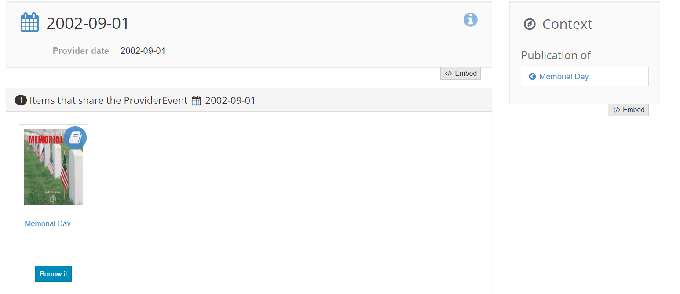
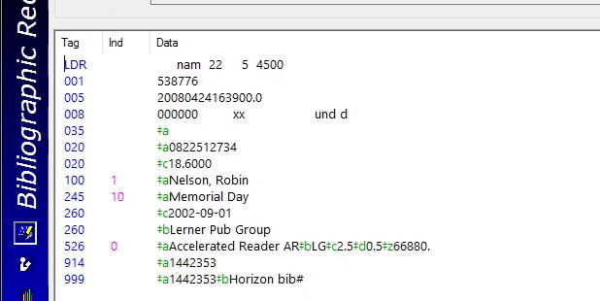
Example: 2002-09-01?
Notes:
Another example of a erroneous provider event/date

Slide 47
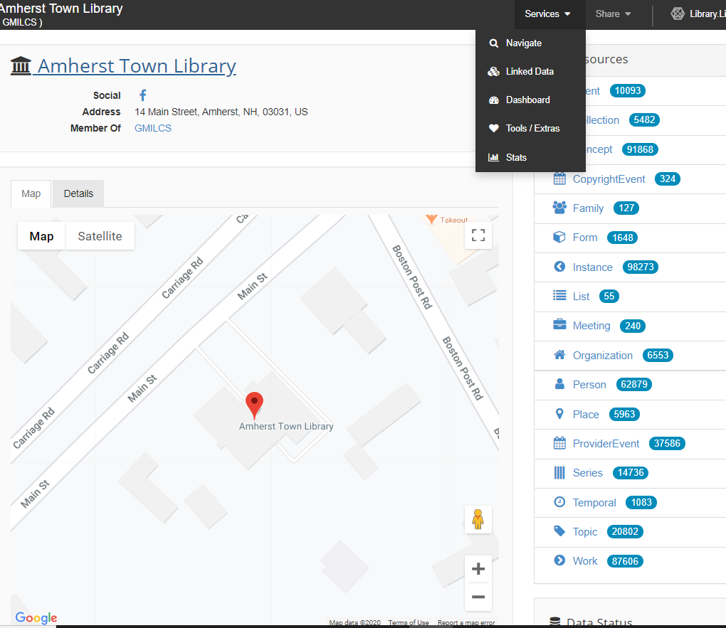
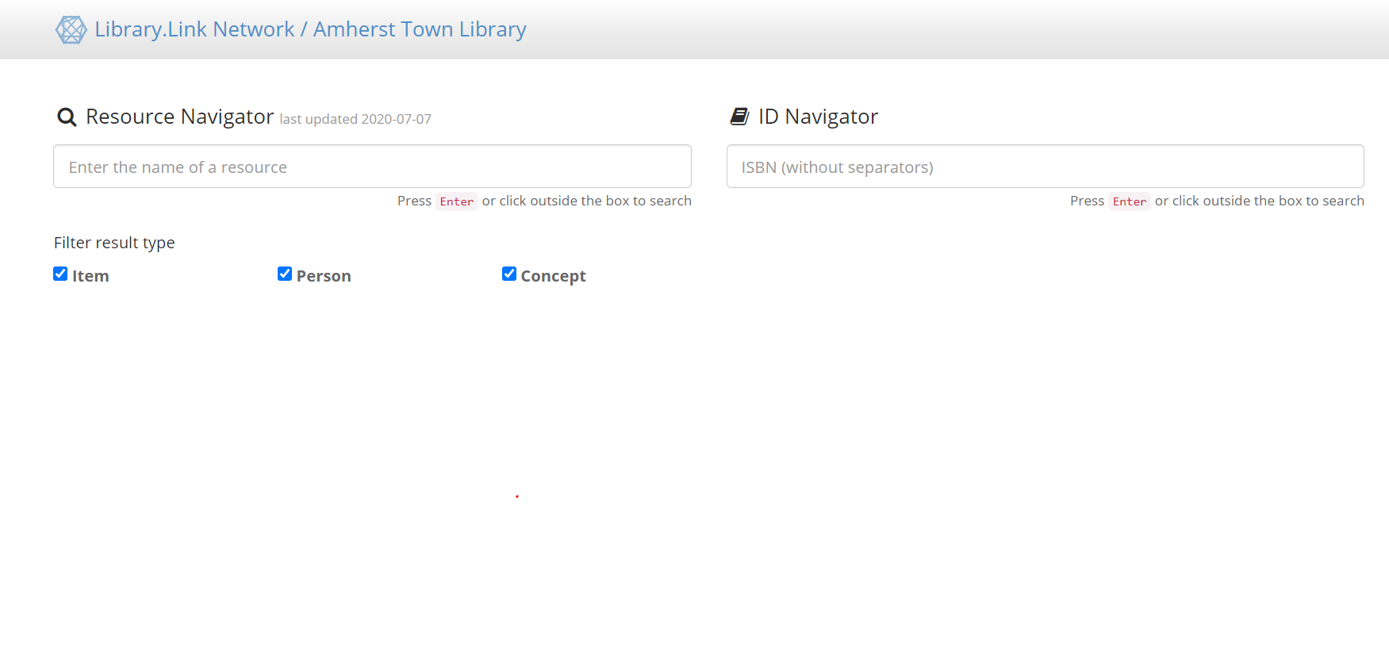
Resource Navigator
Notes:
How to get to Navigate search from the main page

Slide 48
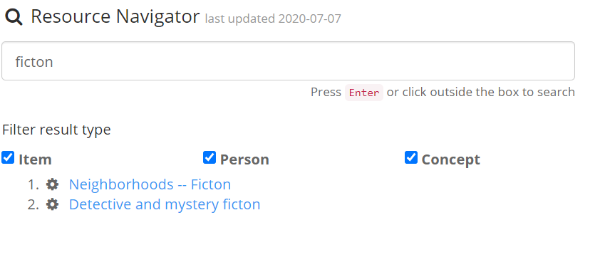
Resource Navigator
Search for common errors
Notes:
-The Resource Navigator can be used to search for common errors, such as misspellings

Slide 49
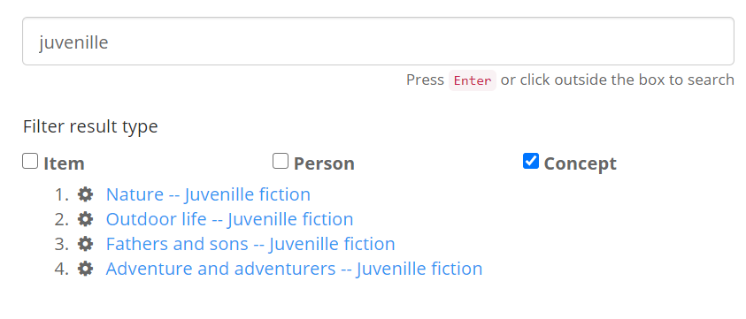
Resource Navigator
Search for common errors
Notes:
Another example of searching for a known misspelling

Slide 50
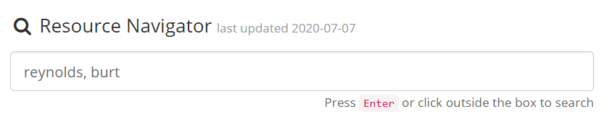

Resource Navigator
Authority heading issues
Notes:
-Most likely issues/errors are found when searching for Resources in an RA context (i.e. to build carousels) (to be seen in next section of presentation)
-Here there are two headings for Reynolds, Burt

Slide 51


Maybe it’s not really an issue!
Notes:
-It turns out this isn’t really an error. These are both legitimate headings. One is probably LC Authority Record or the heading appearing in the 100, 600, or 700 field. The other resource is a Fast Heading.
-It’s still strange that there are two, but it’s not wrong

Slide 52



But…sometimes it’s an issue
Notes:
-Here’s another duplicate example for Roberts, Nora.
-The error is somewhat subtle but you may spot it on this slide
-Clearly there’s something wrong here.

Slide 53




Punctuation makes a difference!
Notes:
-After reviewing some MARC records, it becomes clear that there is a comma missing between Roberts and Nora.
-These are likely ebook records that all have this same error and so there are two resources for Roberts, Nora on the LD page.
-This is especially hard to find in the catalog, because punctuation is often ignored by the system.

Slide 54


Mccarthy, Cormac Before and After
Before
After
Notes:
-An example duplicate Person resources that once existed on the LD page.
-Some cleanup work in the catalog made a big differences
-It went from 2 erroneous entries for the author to the correct heading.

Slide 55
Challenges
Time consuming
No instance updates
Might be impossible for big databases
Many records need to be edited individually
Never complete!

Slide 56
Why this works
New way to look at library data
Find errors and issues that are difficult to spot in traditional catalog
Changes can be done in bulk
Almost anyone can do it
Enhances and improves the catalog!

Slide 57
Resources
https://sites.uwm.edu/mll/linked-data-for-beginners/

Slide 58
Linked Data and Readers Advisory Sue Harmon
Notes:
My name is Sue Harmon and I’ll be going over how I use Linked Data for online Readers Advisory and general virtual outreach.

Slide 59

Introduction
Sue Harmon
Manchester City Library
Information & Technology Librarian
Program planning, Reference, Readers Advisory, Technology
TechNet Liaison for GMILCS
REference and ADult Services (READS) section of NHLA
Membership Chair
Notes:
GMILCS – Greater Manchester Integrated Library System: Amherst, Bedford, Derry, Goffstown, Hooksett, Manchester, Merrimack, Milford, Salem, Windham, and New England College.

Slide 60

Practical Applications
Strategic Plan
Marketing / library brand awareness
Inclusion of diversity/multiculturalism
Education of government officials & citizens
Mission Statement
Lifelong learning / Education
Community Outreach/Engagement
Notes:
I was introduced to Linked Data when Kevin presented at MCL in about 2018. Book carousels were already built into the Zepheria software, but only through preset book lists, which I’ll show you later.
I immediately wanted to find a way to be able to customize book carousels to include books that may not necessarily be related by subject heading, author, or genre. I do a lot of book displays around the library, and I saw a tool that could one day get my book displays online.
It’s always a good idea to be able to link your new projects with your library’s strategic plan and mission statements, especially if you’re spending money. For example, book carousels support the Manchester City Library’s …… (slide) SP: promote, MS: Vehicle

Slide 61

Readers Advisory
Increase awareness of Library’s online presence
Attract new patrons
Frequent posts impact Social Media algorithms
Custom booklists allows for:
Targeted collection promotion
More inclusion of marginalized groups
Educational initiatives
Collaboration with Community Organizations
Notes:
How do I use book carousels for Reader’s advisory?
Like I said, I was responsible for the librarys book displays, which is a passive sort of RA. I wanted a way to make these displays visible outside the library’s walls, and these book carousels allow us to do that.
Being online, means that—hopefully—a greater number of people will see them and possibly attract new patrons, especially if you incorporate Social Media. When you post frequently on FB and other SM, you stay relevant and the algorithms increase your visibility.
Customizing beyond author and subject allows for greater flexibility and can make the book selections more relevant to a target audience: (slide)

Slide 62


Living Lists
EBSCO recently acquired Linked Data
Library Aware (NoveList)
Notes:
So I mentioned preset lists available through Zepheira, and these are two collections. One set is the NYT Bestseller lists, and the other is lists made available through NovelList.
They’re easy to use, and already built, so you don’t have to do anything.

Slide 63


Easy to use
Updated live to reflect current titles.
Monthly data loads update your collection
Set it and forget it: Embed a widget into your library website
Notes:
Here is an example of what the list looks like, based on what we own. (this is an old screen capture)
Zephiera updates what’s on the list—NYT weekly
Data load—from our collection-- updates the carousels with what the library owns out of that list
Set it and forget it (slide) update without you doing anything.

Slide 64

Resources
Person
Author tributes
Composers
Directors
Concept
Subject Headings
Time periods
Genres
Places
Travel
Special Interest
Notes:
But say you want a list that is made up of works from a particular author, or in a certain genre, or set in a certain location; you’re going to want to make use of “Resources”
What are rescources?
Resources = MARC terms
Person can be author or composer
Concept is a subject heading, including time periods
Places can be subject headings and publisher information
This takes a while to wrap your head around, but it works out. I promise. Just wait.

Slide 65

Searching
Notes:
The first way that I find resources is through the search, which is called Navigate
If I want to share a resource for a blog page, let’s say an author obituary post, I can search for specific resources using the navigate function — but it’s not perfect.

Slide 66

Person
Notes:
This search for Toni Morrison first only bring up her “concept” —the gear gives it away.
Uncheck item and concept and you get the person you’re looking for.

Slide 67


Notes:
Toni Morrison died August 5, 2019. So If I wanted to do an anniversary memorial display, I could easy do that with the tools on this page. There are four graphics on this page that are sharable by embed code. I can share the resource, which will link people to this page, essentially. I can share books by or about Toni Morrison, or I can share the context box, which lists the titles that her name is connected with—including the audio books she narrated.

Slide 68

Example: Toni Morrison
Notes:
I’ve chosen here to share items by Toni Morrison. When I click on the embed button, I get text to copy and a preview of what it will look like on my blog.
Embed code left, preview on the right
You can just copy and paste, and it will live in that blog post and you don’t really have to worry about the links expiring.

Slide 69

Concept
Notes:
Another resource to share is the “concept”. Here, I’m searching for the concept “Racism”. You’ll see three entries for the basic subject heading, and I‘m not sure if that is a mistake or not, but it’s still workable.

Slide 70

Notes:
The page for the “Racism” concept looks a lot like the Person resource page, and it has the same sharing options.

Slide 71

Example: Books on Racism
Notes:
And you share the resource the same way.

Slide 72

Browsing
Notes:
Sometimes its easier to browse for the resource you want for your online display.
We’re going to browse for the place “Italy”

Slide 73

Browsing: Italy
Notes:
Focus on Italy
OOPS! Looks like there’s a few erros

Slide 74


Italy
Notes:
The Resource Page for the Place Italy include items about Italy, books published in italy, and includes italy as the sub-focus. So that’s cool.
If you can see, there are 766 items about Italy—too big. It includes fiction and nonfiction and all formats of those titles.
How would you narrow that down? Well, that’s up next.

Slide 75
Lists and Mixes
Lists
Mixes
Specific book selections
New Books
Staff Picks
Genre Awards
Combining Resources
Author Lists
Special Collections
Non-book materials
Subject-headings
Notes:
Now we’re getting into more customized, targeted collections.
Lists are for specific book selections were you have a list of ISBNs. Some examples are: (slide)
Mixes are for… (slide)

Slide 76

List: Genetics
Notes:
Here’s an example of a custom-made list. It looks very similar to the resource carousels, but the difference is that I chose these books.
One handy feature is that if you have titles with multiple formats, you can make the list with “rollup format” which you can see on the right over The Immortal Life of Henrietta Lacks—there are icons to choose ebook, audiobook, or print book.
“rollup format” combines all formats into one title.

Slide 77


Lists: The Bones
Notes:
So here is an example of what it takes to create a customized book carousel. This is .json code for a rollup format book carousel. It’s just a list of ISBNs of the specific books you want. , and I’ve inserted those ISBNs into a template.
It makes a fairly static display. The books won’t change until you change the list or if books are removed.
((MIX NEXT))

Slide 78

MIX: Anxiety Resources
Notes:
Here is an example of a custom-made Mix. I have less control over the exact items that I can put into a mix because it’s a collection of the books assigned particular subject headings. Mixes also don’t support the rollup format, but they require less hands-on maintenance because as books are added to your collection with those subject headings, they will show up in your list.
Mixes can also compensate for multiple resources (e.g., Burt Reynolds—there were 2, but that was correct cataloging). Each of those Burt Reynolds resources had a unique identifier, and I can put both of those in a mix to combine them.

Slide 79

Mixes: The Bones
Notes:
I mentioned Unique Identifiers. This slide shows you what I mean. Each resource has one, and it’s built right into the URL.

Slide 80


Mixes: The Bones
Notes:
Here is what it takes to make a customized mix. This is also .json code, and I’ve inserted my chosen Unique Identifiers into a template.
Right JSON code. Each UI represents a subject heading on the left.

Slide 81

How It’s Made
Gather ISBNs or Unique Identifiers
Write the Code
Upload the Code - Github
Get your Raw URL
String links together
Copy Embed Code
Fix Https
Insert Embed Code into Website
Notes:
I showed you what they’re made of, but what are the steps, exactly? (slide)
These aren’t going to make sense yet, but they will.

Slide 82
Gather ISBNs or UIs
Notes:
Step 1:
Gather your ISBNs through a report or as you browse through your catalog. Or, gather your UIs by navigating or browsing through your Linked Data site.

Slide 83
Write Your Code
List Code
Mix Code
Notes:
Step 2:
Write your code. This is easiest to do by copying from a template and then just inserting your ISBNs or UI into the appropriate spots.
You’ll want to set a brief, but descriptive label and description, as they will display at the top of the book carousel’s page.
One important thing to note is that the code for a mix and a list are different, so make sure you grab the right template.
List = List
Mix = resources

Slide 84

Writing Code
Notepad ++
Atom
sublimetext.com
Notes:
When you’re writing code, there are a number of free software options to use.
Notepad is already on your computer, but isn’t great for this. There are too many quirks and it’s too easy to make errors, and notepad won’t correct you on those.
Code writing tools help you by giving you a little extra structure an helpful shortcuts when you’re writing code.
They also include Visual cues, and they save your document in the correct enconding automatically (JSON needs to be saved in UTF-8 encoding to work). Here, I’m using atom to create a list of new movies.
(side note, many movies don’t have ISBNs, so you need a mix of each movie’s unique identifier)

Slide 85

Writing Code
JSON Playground
Check your Code
Finicky
Notes:
It’s a good idea to run your code through a .json checker. It’ll point out errors that break your code (like a missing comma)
Example: one of my first book carousels had a stray comma that was in a different font that couldn’t be produced in raw code.
A comma broke my code. I wouldn’t have been able to physically see that it was wrong, but the json playground picked up on it.

Slide 86

Upload Code to Github
Github
Free to Use
Version Control
Collaboration
Raw Code URL
Notes:
Step 3 is to upload your code to Github.
We use github because (slide)

Slide 87

Github
Notes:
This is the MCL repository. All of these files are made up of .json code that can be turned into book carousels. Clicking on a file will open up the code that you can edit directly in github.

Slide 88

Get your Raw URL
Notes:
This is what you see when you click open a file. We need a link to the raw code to make a carousel, and Github allows us to do that.

Slide 89

Github: Raw URL
Notes:
So this is what I mean when I say “Raw code URL” It’s a URL that links directly to the .json file hosted on github.

Slide 90

String Links: Lists
Notes:
Now that we have a Raw Code URL, we move on to step 5: stringing the links together. These are the links for a LIST book carousel.
There are 3 links:
Zepheira’s (/lister/) URL + My Library’s Linked Data URL "&list" + Raw code URL = book carousel

Slide 91

String Links: Mixes
Notes:
These are the three links we need to build a MIX
Zepheira’s (/mixer/) url + library’s LD URL "&mix" + raw code URL = Book Carousel

Slide 92

Get the Embed Code
Notes:
Now you have a book carousel! Now you can share it!
When you string all 3 links together and click “go” in your browser, this is the page that is generated. Click the embed code link to get the auto-generated text you can paste directly into a website or blog post.

Slide 93

Copy Embed Code & Fix HTTPs
Notes:
This is what goes into your blog post and website code. Many websites now require HTTPS protocol, but this link has 2 instances where the “s” is missing. Step 6 is just correcting that. After you’ve pasted the code into an email, the blog post, what have you: add the s’s
Optional: You can insert a name into your code, which will allow you to track clicks based on which book carousel has been accessed. Without a name, the stats just clump together. BUT, if you wanted to see if different topics attract more traffic, or if you’ve developed a book carousel for a community partner’s website and you want to see how much traffic they generate, this is how you’d track that.

Slide 94

Community
Partners
Notes:
A few weeks ago, Manchester started exploring partnerships with community organizations to get our library books on their websites. I’ve been working with the NH Jobs Corps to create custom book carousels of MCL resources for their students.
Carousel includes: books on prepping for interviews, some targeted career-path-focused titles.
This is a great way to increase our library’s brand awareness and online visibility.

Slide 95


Social Media
Notes:
The company we use for Linked Data, Zepheira, has some basic options for sharing on social media, but due to Facebook’s protocols and security measures, this feature is underdeveloped currently. We’re hoping to see more integration with social media in the future, but there is some limited ability to share specific titles or pre-made lists in brief post.
It can still be useful for, say, book clubs or author talks.
-One Book One City
-Community Reads, etc.

Slide 96
Uses during Shutdown
New Books
Community Partners
Virtual Outreach
Programming Compliment
Increase access to materials
Notes:
I’ve really begun to see more buy-in from community partners and my colleagues for these features due to the shutdown. Manchester isn’t open to the public yet, so we’ve been reaching out more than ever to bring new books and book displays to our patrons.
Our programs are online, so I can’t have an accompanying display for patrons to walk by, so I’ve been trying to build these book carousels for attendees that want more information. It’s a visually appealing way to showcase our resources. For example, a book carousel of books on dealing with anxiety for an upcoming program: Dealing with Anxiety during Covid.
I’ve reached out to community partners who I’ve worked with on programs or have organized volunteers for us to ask: “How can we still help you, but virtually?”
Ultimate goal: increase access to materials.

Slide 97
Resources
https://github.com/GMILCS
https://json-ld.org/playground/
https://notepad-plus-plus.org/downloads/
https://atom.io/
https://www.isbn.org/ISBN_converter
https://www.w3schools.com/js/js_json_intro.asp
Notes:
Here are some helpful resources you can feel free to explore. (slide)

Slide 98
Thank you!
Kevin French. GMILCS, Inc. kfrench@gmilcs.org
Angela Brown. Amherst Town Library abrown@amherstlibrary.org
Sue Harmon. Manchester City Library sharmon@manchesternh.gov
Notes:
Thank you so much for your interest in our hard work! I feel like this is a powerful tool that can do a lot of to promote library resources. This is our contact information, so please feel free to email us with questions or comments.

